Slide 1
Woodlands CS Club
Dynamic Programming 1
Group A
1/18/2021

Slide 2
What is Dynamic Programming?
Dynamic programming is an optimization mainly over recursion.
Whenever our recursive solution has repeated calls, we can store the results of these subproblems so we do not need to recompute them once we reach these states again.
Let’s look at an example.

Slide 3
Fibonacci Sequence
As discussed in our previous lesson, we can use recursion to find a term in the fibonacci sequence.
The code is something like:
The time complexity of this algorithm is exponential though: about O(2^N)
Let’s look at the recursion tree for f(6)
def f(n):
if(n == 0):
return 1
if(n == 1):
return 1
return f(n-1) + f(n-2)

Slide 4
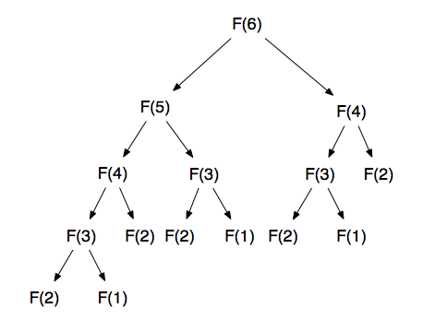

Slide 5
Observations:
We notice that we have overlapping subproblems.
In our recursion tree, we notice that we recompute f(4) even though we’ve already computed it once.
Let’s apply dynamic programming to optimize this. For every DP problem, we need to identify these key elements:
Define DP states
What does each state represent in our problem? How will you store these states?
Find the DP transition/recurrence
How are the DP states related to each other? How can you use previously computed states to calculate your current state?
Define the base case
What are the values/states?
Define the end case
What state are you trying to find?

Slide 6
1: Define DP States
We can store the value of the N-th Fibonacci number because in our recursive solution we recompute states that we’ve already calculated.
We can store these values in an array.
fibonacci_num[i] = i-th fibonacci number
DP states are sometimes called DP subproblems because they store the result of some subset of our entire problem.
We then find some way to store these states.
Fibonacci Sequence:
What are the subproblems that we can store?

Slide 7
2: Define DP Transition
In the Fibonacci sequence, our current state (the i-th Fibonacci number) is dependent on the two previous Fibonacci numbers.
Therefore,
fibonacci_num[i] = fibonacci_num[i-1] + fibonacci_num[i-2];
Once we have defined the DP states, we need to define how these states are related with one another. Usually, this involves calculating a current state based on previous values. Much like recursion, we are defining sub-problems by using smaller sub-problems.
Fibonacci Sequence:

Slide 8
3. Define Base Case
Much like our recursive solution, our base case are the values that we are initially provided with.
Since F₀ = 1 and F₁ = 1:
fibonacci_num[0] = 1;
fibonacci_num[1] = 1;
What are the starting values of our DP states? Since our transition depends on previous computed values, we need to give our program some initial values. If we apply our transition on a DP array with no values, we will get no answer.
Note that a base case is not always a single value nor is it always multiple values.
Fibonacci Sequence:

Slide 9
4. Define End State
Since we want to find the n-th fibonacci number, our end state is fibonacci_num[n].
What are the ending values of our DP states? This final state is what we use to compute the answer (if it is not our answer directly).
Note that this end state is not always a single value nor is it always multiple values.
Fibonacci Sequence:

Slide 10
Problem 1: https://dmoj.ca/problem/dpa

Slide 11
Steps:
Define DP States:
Our state will be the minimum cost to get to stone i. We can store this in an array. (dp[i] = min cost to get to i-th stone)
Define DP transition:
How can we use previous states to define our current state? Much like our Fibonacci sequence problem, our current state is dependent on our previous two states. Since we can only jump one or two stones, stone i is only reachable from stone i-1 or stone i-2. We can compute which stone would result in a lower value and set it to dp[i].
dp[i] = min(dp[i-1] + abs(height[i-1]-height[i]), dp[i-2] + abs(height[i-2]-height[i]));
Define DP Base Case(s):
The cost to get to stone 1 is 0 (we start on stone 1). The cost to get to stone 2 is the difference in heights between stone 1 and stone 2 (there is no stone 0, so we can only reach stone 2 from stone 1).
Define DP End State:
We want the minimum cost to get from stone 1 to stone N. Thus, our end state is dp[N].

Slide 12
Frog 1 Code
#include <bits/stdc++.h>
using namespace std;
int main() {
int n; cin >> n;
int height[n+1], dp[n+1];
for(int i = 1; i <= n; i++) cin >> height[i];
dp[1] = 0; // base case
dp[2] = abs(height[1] - height[2]); // base case
for(int i = 3; i <= n; i++) {
dp[i] = min(
dp[i-1]+abs(height[i-1]-height[i]),
dp[i-2]+abs(height[i-2]-height[i])
);
}
cout << dp[n] << '\n'; // end state
}
n=int(input())
height=[0]+list(map(int,input().split()))
dp=[0 for i in range(n+1)]
dp[1] = 0
dp[2] = abs(height[1]-height[2])
for i in range(3,n+1):
dp[i] = min(
dp[i-1] + abs(height[i-1]-height[i]),
dp[i-2] + abs(height[i-2]-height[i])
)
print(dp[n])

Slide 13
Problem 1: https://dmoj.ca/problem/ccc00s4

Slide 14
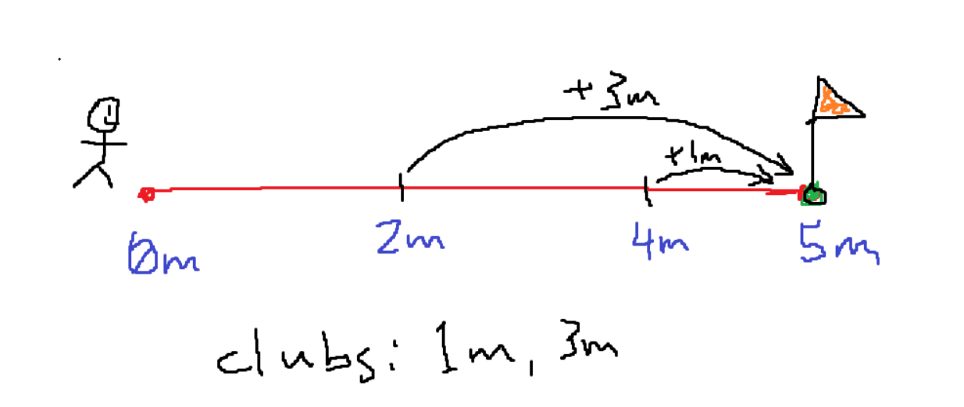
Steps:
Define DP States:
dp[i] = min. # of strokes to reach i meters
dp[5] = min(dp[2], dp[4]) + 1
Define DP transition:
Since the clubs always hit an exact distance, our current state only depends on states that are a specific club’s hit range away. (If we have clubs a, b, c, we can reach dp[i] from dp[i-a], dp[i-b], dp[i-c])
Define DP Base Case(s):
0 strokes to get to 0m. Also can’t get to a spot if the club hits further.
Define DP End State:
We want the minimum # of strokes to reach the hole. End state is dp[distance to hole]

Slide 15
Golf Code
#include <bits/stdc++.h>
using namespace std;
int dp[5281]; int clubs[32];
int main() {
int distance, c; cin >> distance >> c;
dp[0] = 0;
for(int i=0; i<c; i++) cin >> clubs[i];
for(int i=1; i<=distance; i++){
dp[i] = INT_MAX-1;
for(int x: clubs){
if(i-x>=0) dp[i] = min(dp[i], dp[i-x]+1);
}
}
if(dp[distance] == INT_MAX-1) {
cout << "Roberta acknowledges defeat.";
}else {
cout << "Roberta wins in " << dp[distance] << " strokes.";
}
}
n=int(input())
k=int(input())
clubs=[int(input())for i in range(k)]
dp=[2**32 for i in range(n+1)]
dp[0] = 0
for i in range(1,n+1):
for club in clubs:
if(i - club >= 0):
dp[i] = min(dp[i],dp[i-club]+1)
if(dp[n]==2**32):
print("Roberta acknowledges defeat.")
else:
print("Roberta wins in",dp[n],"strokes.")

Slide 16
Problem 3: https://dmoj.ca/problem/ccc18s4 (9 point subtask)

Slide 17
Hints
Top down (recursion) is better then bottom up, as you can skip a lot of states
Consider using an array to cache already computed states
Make sure you use a long long

Slide 18
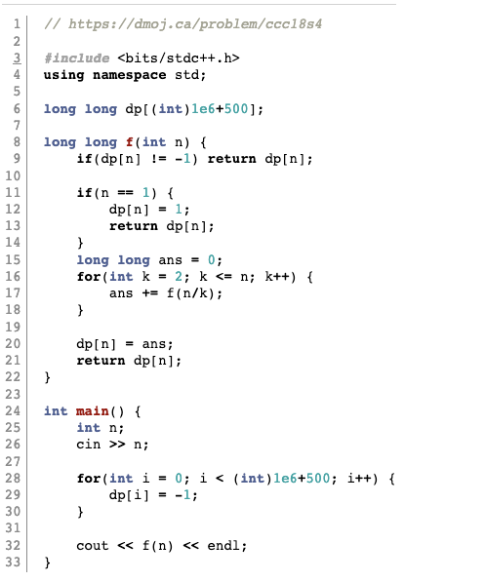
Code

